Slide 1




Hepatitis B
Understanding Hepatitis B and Promoting Testing in African Immigrant Communities
A guide for community health workers, health educators, healthcare providers and other professionals

Slide 2



Why is Hepatitis B Relevant to Me?

Slide 3
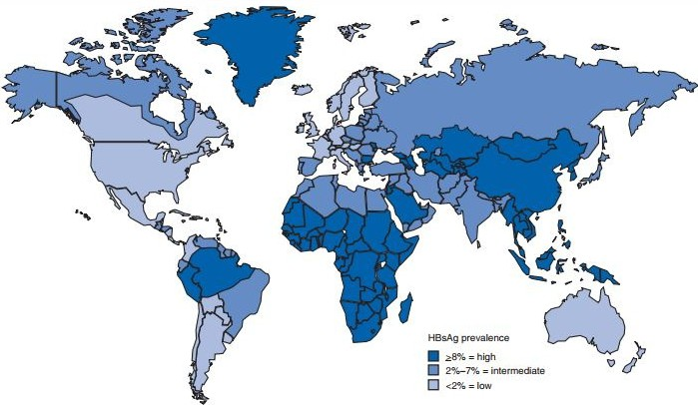




Because...
PA GE | 00
Hepatitis B is one of the world's most common
infections.
Hepatitis B is more
common among people who were born in Africa and other parts of the
world.
In African communities in the U.S., between
5% and 18% of
people have hepatitis B.

Slide 4

What is Hepatitis B?
PA GE | 00
Hepatitis B is a viral infection that can cause serious liver
disease and even liver cancer.

Slide 5



Keeping your liver healthy is important because it has many jobs in your body.
Digests food.
Regulates energy.
Builds muscle.
Breaks down toxins.
Fights infections.
Processes medications.
Stores vitamins.
Helps the blood to clot.

Slide 6


People cannot live without their liver!

Slide 7
The good news:
When managed by a doctor,
hepatitis B is a disease that people can live with for a long time.
By taking care of their health, people can have a long and productive life.

Slide 8
You can help keep
the community healthy by learning about hepatitis B and promoting awareness and testing.

Slide 9



The Basics of Hepatitis B

Slide 10





















Worldwide
Hepatitis B is one of the world's most common infections.
Almost 300 million people are living with hepatitis B
In the United States
More than 2 million people have hepatitis B infections

Slide 11



Most people with hepatitis B do not know that they are infected!

Slide 12


Acute
PA GE | 00
There are 2 kinds of hepatitis B infections.
Chronic
Short-term infection
Lifelong infection

Slide 13
The age when someone becomes infected determines what type of infection they will have.
PA GE | 00
Acute
An infection that lasts less than 6 months
Chronic
An infection that lasts for life
Less common
Usually occurs by
getting infected as an adult Usually clears from the body within 6 months
More common
Usually occurs by getting infected during childhood Usually lasts for life

Slide 14


Although hepatitis B can be prevented with a vaccine at birth, not all babies receive the vaccine.
Many pregnant women do not know they are infected, and unknowingly transmit the virus to their babies.
Without the vaccine, most of these will develop into chronic, lifelong infections.

Slide 15

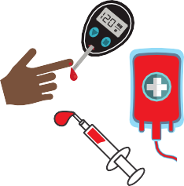





Someone can also get hepatitis B through:
Blood
Direct blood to blood contact
Sex
Direct contact with sexual fluids of an infected person
Mother to child during birth
healthcare exposures
Household contact
Sharing hygiene equipment (razors, toothbrushes,
earrings etc.)
Unprotected Sex
Tattoos, piercings, barbers, scarification, circumcision practices
There is a risk during any type of sexual contact
Sharing needles

Slide 16







Hepatitis B is NOT spread by:
Food
Or sharing meals with someone who is infected
Sneezing or coughing on someone
Touching
Hugging
Water
Drinking from a cup of someone who is infected or sharing a toilet
Breastfeeding
Kissing

Slide 17












Less than 10% of people infected with chronic hepatitis B have symptoms.
If symptoms occur with chronic hepatitis B, they can be a sign of advanced liver disease:
Yellow skin or eyes, abdominal pain, vomiting, feeling tired, joint pain,
dark urine or clay colored stool

Slide 18
Although hepatitis B is common in Africa, most people do not know they are infected.
People can be afraid to get tested. They may
incorrectly believe they would have symptoms, or hold on to myths or do not have access to
health care.
Not knowing about an infection is a health risk.
Without regular healthcare and possible treatment, a person with hepatitis B faces an increased risk of dying early or unknowingly infecting others.

Slide 19

The test for hepatitis B is a simple blood test.
It can be done at the family doctor, liver specialist or at a community health fair.
It is quick and easy and the results will be available in a few days.

Slide 20
CDC Universal Adult Hepatitis B Screening/Testing Recommendations
CDC recommends that all adults in the U.S. aged 18 years and older be tested for hepatitis B at least once.
All pregnant people should be tested during each pregnancy.
CDC recommends additional risk-based testing for the following groups: Persons incarcerated/formerly incarcerated; persons with a history of sexually transmitted
infections or multiple sex partners; and persons with hepatitis C virus infection.
Anyone who requests HBV testing should receive it, regardless of disclosure of risk.
This will minimize the stigma associated with testing and will get more people diagnosed!

Slide 21
CDC Universal Adult Hepatitis B Vaccination Recommendations
CDC recommends hepatitis B vaccination for all adults aged 19–59 years, and any adult aged 60 years or older with one or more risk factors (although adults aged 60 years and older without known risk factors for hepatitis B may also receive
the hepatitis B vaccine!)
Infants and all other persons aged 19 years and younger in the U.S. are recommended to receive the hepatitis B vaccine.

Slide 22




After someone is tested:
If the test results show that
Someone is NOT infected
They should get vaccinated to prevent hepatitis B
Someone is infected
They should see a doctor for additional testing
Have family members and sexual partners tested

Slide 23




People who test positive for hepatitis B can stay healthy by:
Seeing their doctor 1-2 times a year.
Ideally a doctor experienced in managing hepatitis B
They will perform additional tests
and, if needed, recommend treatment
Leading a healthy lifestyle.
Eating a nutritious diet Staying physically active
Avoiding alcohol and cigarettes
These contain toxins that can harm the liver

Slide 24
There is no cure for chronic hepatitis B.
Claims that medicine or herbal remedies can cure the virus are false.
CANNOT CURE

Slide 25
There are treatments for hepatitis B.
PA GE | 00
But, the good news is that...
There are treatments, called antivirals, that can effectively control the virus and prevent liver damage.

Slide 26







Why should people get tested for hepatitis B?
PA GE | 00
Hepatitis B can be managed and treated!
Most people do not have symptoms.
Someone should not wait until they feel sick.
They should get tested now!
There is a safe and effective vaccine that can protect loved ones who don't have hepatitis B.
Getting tested now can allow someone to stay healthy for themselves and their loved ones!

Slide 27



You have the power to save lives by: Educating about hepatitis B Promoting testing in your community

Slide 28

Talking about hepatitis B in a culturally sensitive way can be challenging.
PA GE | 00
Knowing the common
misconceptions and how to overcome them can help dispel stigma and
convey accurate information.
HEY!

Slide 29










Symptoms
Misconception #1:
I don't have any symptoms.
Could I still have hepatitis B?
Yes.
Most people with hepatitis B
do not have
any symptoms!

Slide 30

Fact #1
Most people with hepatitis B don’t have any symptoms.
Remember:
People may be used to treating illnesses only when they have symptoms. People may not have a sense of urgency to get tested.
Key Tips:
Let community members know that people with hepatitis B often have no symptoms, even though their liver could be damaged.
Remind people that they have the power to improve their health now, to prevent serious liver problems in the future.
The hepatitis B test is a simple blood test. It is the only way to know if someone is infected!

Slide 31


_{M}M_{is}i_{c}sc_{o}o_{n}nc_{c}e_{e}p_{p}ti_{t}o_{i}n_{o}#_{n}2#: ₂
PA GE | 00
Transmission
I haven’t done
anything risky to get hepatitis B.
Could I still have it?
Yes.
Most people
contract hepatitis B as babies or children.

Slide 32
Fact #2
Most people living with hepatitis B were infected at birth or early childhood.
Remember:
Some people associate hepatitis B with unhealthy or risky behaviors. People may not be aware of how most people become infected.
Key Tips:
Reinforce the most common way hepatitis B is transmitted; which is through blood contact at birth or during early childhood.
Reminding them that hepatitis B is one of the world’s most common infections may be helpful in normalizing testing.

Slide 33

_{M}M_{is}i_{c}sc_{o}o_{n}n_{c}ce_{e}p_{p}ti_{t}o_{i}n_{on}#3#: ₃
PA GE | 00
Medical Care
Are there
treatments for hepatitis B?
Yes.
Treatments are available that
can help people
stay healthy.

Slide 34
Fact #3
Treatments are available that can help people stay healthy.
Remember:
People may be worried that a hepatitis B diagnosis will change their whole life – but it doesn’t have to!
Key Tips:
People with hepatitis B can still live long, healthy and productive lives.
Hepatitis B usually progresses slowly. The biggest danger is not knowing someone is infected!
Hepatitis B can be managed effectively over time by seeing a doctor and taking treatment if it is needed.

Slide 35


Be Aware:
There can be stigma and fear associated with hepatitis B.
Let's learn more about how to overcome these barriers when educating.

Slide 36






Dispelling Stigma: Misinformation
Stigma can come from misinformation.
Misinformation can create assumptions about how someone may have gotten the virus.
People may assume that people have contracted hepatitis B through:
Immoral behavior Drug use
Having many sex partners

Slide 37





Dispelling Stigma: Misinformation
To overcome misinformation, emphasize the facts!
People most commonly get hepatitis B from:
Their mothers during birth Contact with blood during early childhood
Anyone can get it regardless of their cultural or religious values

Slide 38
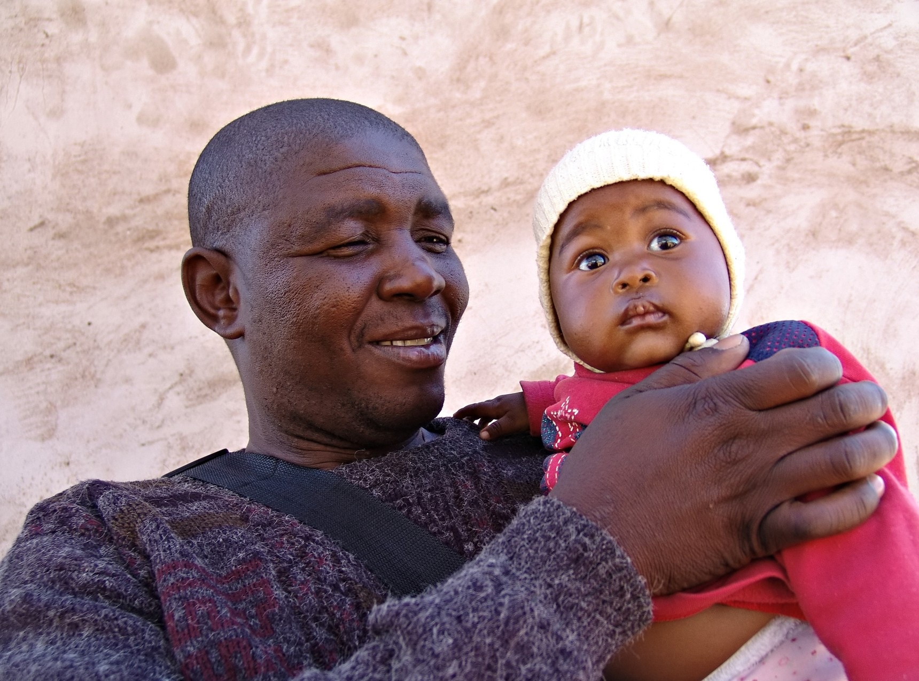


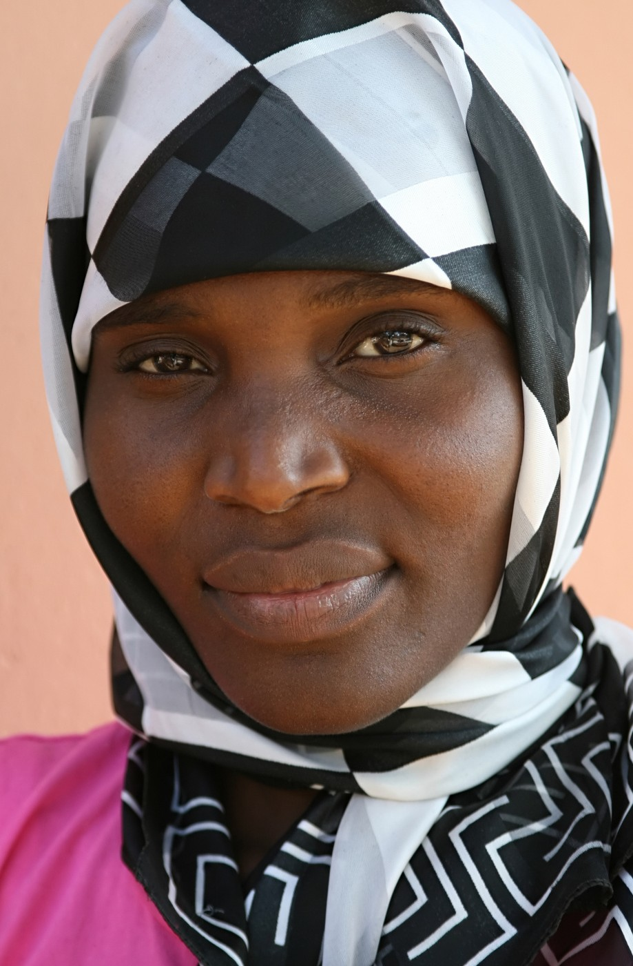




Dispelling Stigma: Fear
Stigma can also come from fear.
Being seen getting tested
Managing a hepatitis B infection Cost
Seeing a doctor regularly
Family burden
Social stigma
Isoaliton from friends and family Community judgment

Slide 39



Dispelling Stigma: Fear
To overcome fear, normalize hepatitis B testing and emphasize available resources.
Resources are available to help people living with hepatitis B.
Hepatitis B is a very common virus, and can be managed effectively by seeing a doctor and making simple lifestyle changes.
The more correct information the community knows, the less stigma that will exist around hepatitis B!

Slide 40

You play an important role in your community,
and you have the power to promote awareness and testing for hepatitis B!
PA GE | 00
Key tips:
Never invalidate someone's concerns. Always encourage community members to become empowered and
proactive about their health, so they can stay healthy
for themselves and their families.
If someone tests positive for hepatitis B, there are many resources available to help them manage
their infection, even if they do not have insurance.
A hepatitis B diagnosis isn't a death sentence, and by living a healthy lifestyle and monitoring it with the
doctor, people can live long and productive lives!

Slide 41






You are not alone! There are resources available to help:
PA GE | 00
How can I locate doctors for testing and care?
The Hepatitis B Foundation's Liver Specialist Directory www.hepb.org/physiciandirectory
Federally Qualified Health Center (FQHC) Locator www.findahealthcenter.hrsa.gov
Where can I find more information on hepatitis B?
Centers for Disease Control and Prevention (CDC)
Basic information about hepatitis B, guidelines and downloadable PDFs
Printable fact sheets, PSA videos, infographics, quizzes
and more in multiple languages Free posters
www.cdc.gov/knowhepatitisB
The Hepatitis B Foundation
Phone and email helplines Comprehensive information Printable fact sheets
Inspiring videos
www.hepb.org

Slide 42
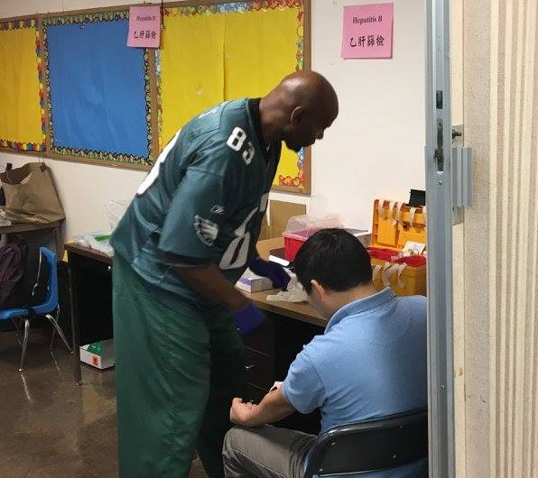

There are many ways that you can integrate hepatitis B education into your community.
Talk to community members about their
health and hepatitis B risk.
Display educational fact sheets, brochures and posters in your office.
Host an education
session, health fair or hepatitis B testing event.
Promote a local health fair that is testing for hepatitis B.
Share CDC's and the Hepatitis B Foundation's
posts on social media.

Slide 43
The toolkit contains more details and support for
integrating these ideas.

Slide 44
Thank you for helping spread the word about hepatitis B!
PA GE | 00

Slide 45
After viewing this presentation, please complete a short self-assessment.
Click Here!
Your feedback can help us provide you with the most useful resources!
For questions or additional support, email: info@hepb.org

