Slide 1




Hepatitis B
Understanding Hepatitis B and Promoting Testing in Filipino Communities
A guide for community health workers, health educators, medical staff and other professionals

Slide 2



Why is Hepatitis B Relevant to Me?

Slide 3

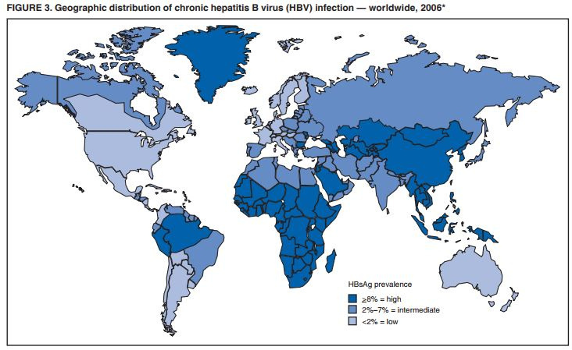


Because...
PAGE | 00
Hepatitis B is one of the world's most common infections.
Hepatitis B is more common among people who were born in Asia and other parts of the world.
Half of all people living with hepatitis B in the United States are Asian-American or Pacific Islander, though these communities only account for about 6% of the total US population.

Slide 4

PAGE | 00
What is Hepatitis B?
Hepatitis B is a viral infection
that can cause serious liver disease and even liver cancer.

Slide 5





Keeping your liver healthy is important
because it has many jobs in your body.
Digests food.
Regulates energy.
Builds muscle.
Breaks down toxins.
Fights infections.
Processes medications.
Stores vitamins.
Helps the blood to clot.

Slide 6


People cannot live without their liver!

Slide 7


PRESENTATION TITLE | QUOTE
PAGE | 00
The good news:
When managed by a doctor,
hepatitis B is a disease that people can live with for a long time.
You can help keep your community healthy by learning about hepatitis B.
By taking care of their health, people can live a long and productive life.

Slide 8
You can help keep your community healthy by learning about hepatitis B and promoting awareness and testing.

Slide 9



The Basics of Hepatitis B

Slide 10


Hepatitis B is one of the world's most common infections.
Worldwide
Almost 300 million people
are living with hepatitis B
In the United States
Around 2.4 million people have
hepatitis B

Slide 11




Most people with hepatitis B do not know that they are living with the virus!

Slide 12

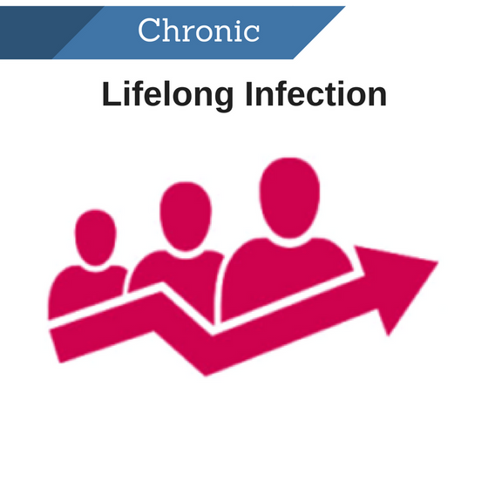
PAGE | 00
There are 2 kinds of hepatitis B infections.
Acute
Chronic
Short-term infection
Lifelong infection

Slide 13
PAGE | 00
The age when someone contracts the virus
determines what type of infection they will have.
Acute
Chronic
An infection that lasts
less than 6 months
An infection that lasts for life
  Less common
  Usually occurs by contracting the virus as an adult
  Usually clears from the body within 6 months
  More common
  Usually occurs by contracting the virus during childhood
  Usually lasts for life

Slide 14


Although hepatitis B can be prevented with a vaccine at birth, not all babies receive the vaccine.
Many pregnant people do not know they have the virus, and unknowingly transmit it to their babies.
Without the vaccine, the virus is much more likely to develop into a lifelong, chronic condition.

Slide 15

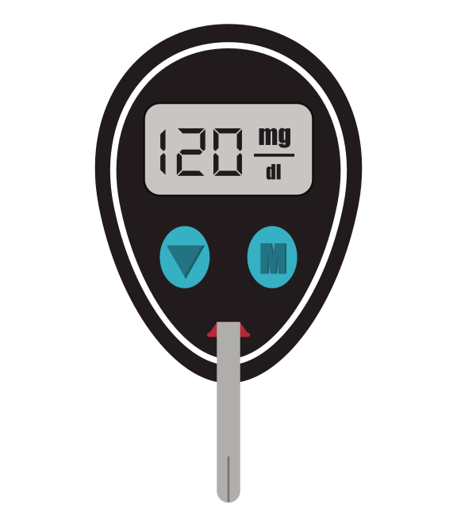












Someone can also get hepatitis B through:
Blood
Sex
Direct blood to blood contact
Direct contact with bodily fluids of someone living with hepatitis B
Mother to child during birth
Healthcare exposures
Household contact
Sharing hygiene equipment
(razors, toothbrushes, earrings etc.)
Unprotected Sex
Tattoos, piercings, barbers,
scarification, circumcision practices
Sharing needles
There is a risk during any type of intimate contact

Slide 16





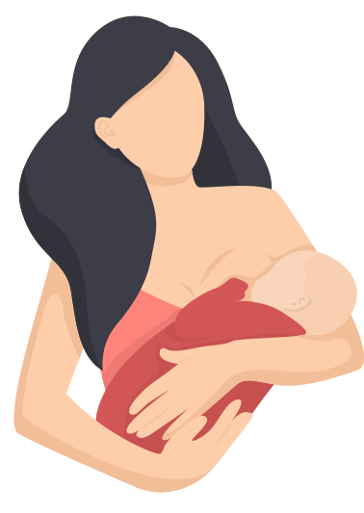


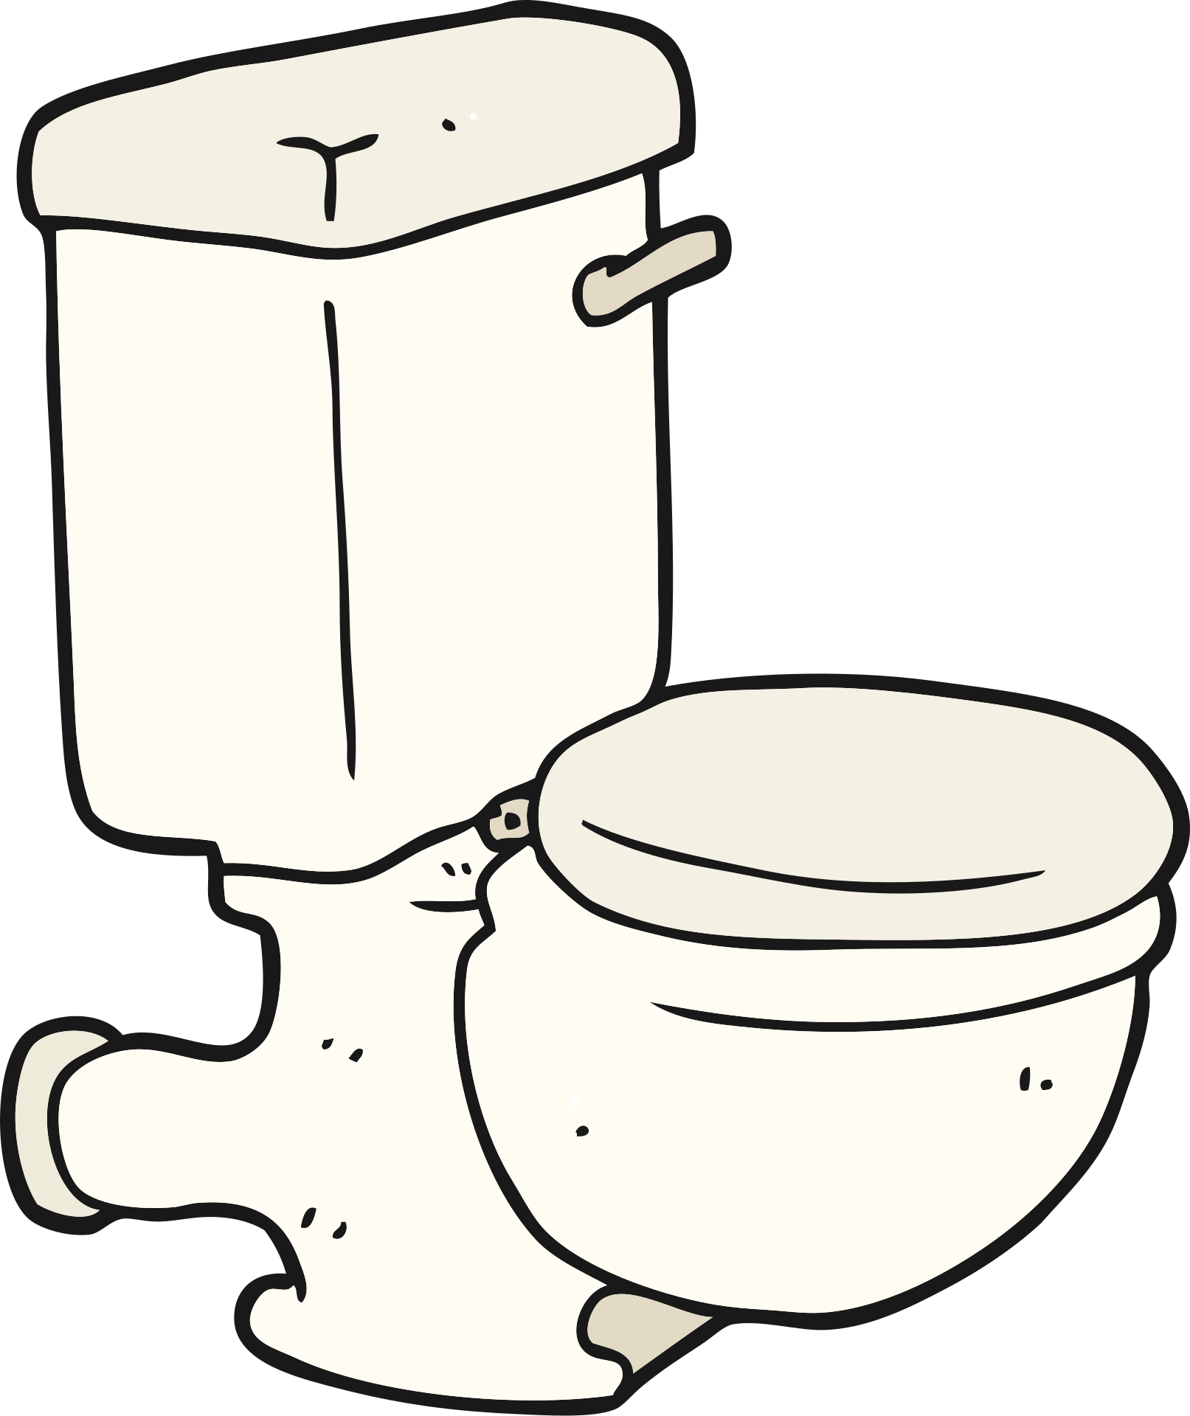

NOT
Hepatitis B is spread by:
Food
Sneezing or coughing on someone
Touching
Or sharing meals with someone who is living with hepatitis B
Hugging
Water
Breastfeeding
Drinking from the same cup as someone who is living with hepatitis B or sharing a toilet
Kissing

Slide 17



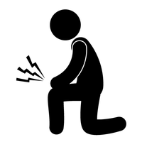





Fewer than 10% of people living with
chronic hepatitis B have symptoms.
If symptoms occur with chronic hepatitis B,
they can be a sign of advanced liver disease:
Yellow skin or eyes, abdominal pain,
vomiting, feeling tired, joint pain, dark urine or clay-colored stool

Slide 18


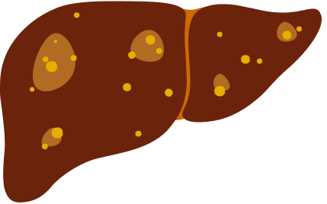

Hepatitis B can lead to liver disease and liver cancer
If hepatitis B goes unmonitored and unmanaged, people are at
much higher risk for liver disease and liver cancer
Progression of liver disease
Healthy Liver
Liver Fibrosis
Liver Cirrhosis
Liver Cancer

Slide 19

Although hepatitis B is common among Asian populations, most people do not know they are living with the virus.
People can be afraid to get tested. They may incorrectly believe they would have symptoms, may hold on to common myths, or may not have access to health care.
Not knowing your hepatitis B status is a health risk.
Without regular healthcare and possible treatment, a person with hepatitis B faces an increased risk of liver disease, liver cancer, or unknowingly transmitting the virus.

Slide 20

The CDC now recommends that all adults in the United States be tested for hepatitis B at least once in their lifetime and that all adults between the ages of 19 and 59 (as well as high-risk adults ages 60+) be vaccinated against hepatitis B.

Slide 21
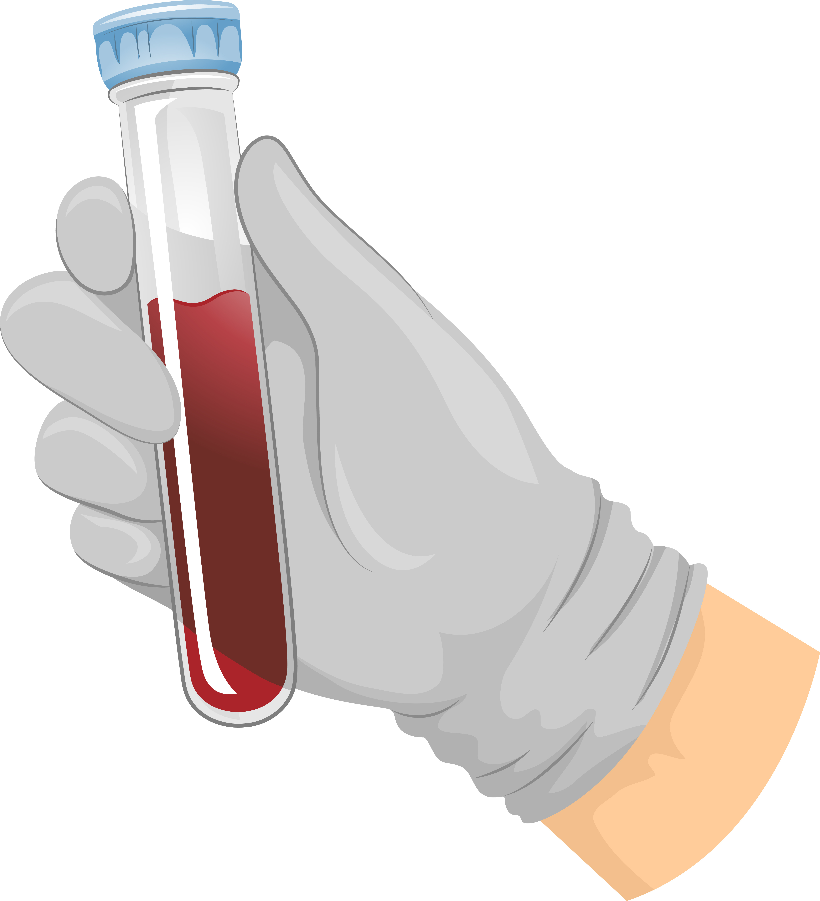
The test for hepatitis B is a simple blood test.
It can be done at a family doctor, liver specialist or at a community health fair.
It is quick and easy and the results will be available in a few days.

Slide 22


After someone is tested:
______
______
______
______
______
______
______
______
If the test results show that
______
______
______
______
______
______
______
______
______
______
______
______
Someone does NOT have the virus
  They should get vaccinated to prevent hepatitis B
Someone does have the virus
  They should see a doctor for additional testing
  Have family members and sexual partners tested

Slide 23





People who test positive for hepatitis B can stay healthy by:
Seeing their doctor 1-2 times a year.
  Ideally a doctor experienced in managing hepatitis B
  They will perform additional tests and, if needed, recommend treatment
Leading a healthy lifestyle.
  Eating a nutritious diet
  Staying physically active
  Avoiding alcohol and cigarettes
These contain toxins that can harm the liver

Slide 24



There is no cure for chronic hepatitis B.
Claims that medicine or herbal remedies can cure the virus are false.
CANNOT CURE
CANNOT CURE

Slide 25



PAGE | 00
There are treatments for hepatitis B.
But, the good news is that...
There are treatments, called antivirals, that can effectively control the virus and prevent liver damage.

Slide 26








PAGE | 00
Why should people get tested for hepatitis B?
Hepatitis B can be managed and treated!
Most people do not have symptoms.
Someone should not wait until they feel sick.
They should get tested now!
There is a safe and effective vaccine that can protect loved ones who don't have hepatitis B.
Getting tested now can allow someone to stay healthy for themselves and their loved ones!

Slide 27



You have the power to save lives by:
  Educating about hepatitis B
  Promoting testing in your community

Slide 28



PAGE | 00
Talking about hepatitis B in a
culturally sensitive way can be challenging.
Knowing the common misconceptions and how to overcome them can help dispel stigma and convey accurate information.

Slide 29



Misconception #1:
PAGE | 00
Symptoms
I don't have any symptoms.
Could I still have hepatitis B?
Yes.
Most people with hepatitis B do not have any symptoms!

Slide 30


Fact #1
PAGE | 00
Most people with hepatitis B don’t have any symptoms.
Remember:
People may be used to treating illnesses only when they have symptoms. People may not have a sense of urgency to get tested.
Key Tips:
  Let community members know that people with hepatitis B often have no symptoms, even though their liver could be damaged.
  Remind people that they have the power to improve their health now, to prevent serious liver problems in the future.
  The hepatitis B test is a simple blood test. It is the only way to know if someone has the virus!

Slide 31

Misconception #2:
PAGE | 00
Misconception #2
PAGE | 00
Transmission
I haven’t done anything risky to get hepatitis B.
Could I still have it?
Yes.
Most people contract hepatitis B as babies or children.

Slide 32

Fact #2
PAGE | 00
Most people living with hepatitis B contracted the virus at birth or early childhood.
Remember:
Some people associate hepatitis B with unhealthy or risky behaviors. People may not be aware of how most people contract the virus.
Key Tips:
  Reinforce the most common way hepatitis B is transmitted, which is through blood contact at birth or contact with blood of someone living with hepatitis B during early childhood.
  Reminding them that hepatitis B is one of the world’s most common viruses may be helpful in normalizing testing.

Slide 33

Misconception #3:
Misconception #3
PAGE | 00
PAGE | 00
Medical Care
Are there treatments for hepatitis B?
Yes.
Treatments are available that can help people stay healthy.

Slide 34
Fact #3
PAGE | 00
Treatments are available that can help people stay healthy.
Remember:
People may be worried that there is no cure for hepatitis B or that a hepatitis B diagnosis will change their whole life – but it doesn’t have to!
Key Tips:
  People with hepatitis B can still live long, healthy and productive lives.
  Hepatitis B usually progresses slowly. The biggest danger is not knowing your status!
  Hepatitis B can be managed effectively over time by seeing a doctor and taking treatment if it is needed.

Slide 35
Misconception #4:
Misconception #3
PAGE | 00
PAGE | 00
Vaccine Boosters
If I have already been vaccinated against hepatitis B, do I need to get booster shots?
It’s up to you!
If you got tested to make sure you have hep B antibodies, you should be protected for life. But a booster shot won’t hurt!

Slide 36
Fact #4
PAGE | 00
If you respond to the hep B vaccine, you should be protected for life.
Remember:
Even after being vaccinated, loved ones and close contacts of individuals living with hepatitis B may still be concerned about their risk level, even after receiving the vaccine.
Key Tips:
  As long as someone gets vaccinated and then gets tested a minimum of 20 days later to make sure they have antibodies, there shouldn't be a need for a booster shot, as they are protected.
  But, if they do want to get a booster shot, just to have peace of mind, they certainly can - it will not harm them!

Slide 37





Be Aware:
There can be stigma and fear associated with hepatitis B.
Let's learn more about how to overcome these barriers when educating.

Slide 38


Dispelling Stigma: Misinformation
PAGE | 00
Stigma can come from misinformation.
Misinformation can create assumptions about how someone may have gotten the virus.
People may assume that people have contracted hepatitis B through:
  Immoral behavior
  Drug use
  Having many sex partners

Slide 39


Dispelling Stigma: Misinformation
PAGE | 00
To overcome misinformation, emphasize the facts!
People most commonly get hepatitis B from:
  Their mothers during birth
  Contact with blood from someone living with hepatitis B during early childhood
Anyone can get it regardless of their cultural or religious values

Slide 40



Dispelling Stigma: Fear
PAGE | 00
Stigma can also come from fear.
  Being seen getting tested
  Managing the virus
    Cost
    Seeing a doctor regularly
    Family burden
  Social stigma
    Isolation from friends and family
    Community judgment

Slide 41




Dispelling Stigma: Fear
PAGE | 00
To overcome fear, normalize hepatitis B testing and emphasize available resources.
  Resources are available to help people living with hepatitis B.
  Hepatitis B is a very common virus, and can be managed effectively by seeing a doctor and making simple lifestyle changes.
  The more correct information the community knows, the less stigma that will exist around hepatitis B!

Slide 42


PAGE | 00
You play an important role in your community,
and you have the power to promote awareness and testing for hepatitis B!
Key tips:
Never invalidate someone's concerns. Always encourage community members to become empowered and proactive about their health, so they can stay healthy for themselves and their families.
If someone tests positive for hepatitis B, there are many resources available to help them manage the virus, even if they do not have insurance.
A hepatitis B diagnosis doesn't automatically mean that someone will be very sick and unhealthy. By living a healthy lifestyle and monitoring the virus with their doctor, people can live long and productive lives!

Slide 43


PAGE | 00
You are not alone! There are resources available to help:
How can I locate doctors for testing and care?
The Hepatitis B Foundation's Liver Specialist Directory
www.hepb.org/physiciandirectory
Federally Qualified Health Center (FQHC) Locator
www.findahealthcenter.hrsa.gov
Where can I find more information on hepatitis B?
Centers for Disease Control and Prevention (CDC)
  Basic information about hepatitis B, guidelines and downloadable PDFs
  Printable fact sheets, PSA videos, infographics, quizzes and more in multiple languages
  Free posters
www.cdc.gov/knowhepatitisB
The Hepatitis B Foundation
  Phone and email helplines
  Comprehensive information
  Printable fact sheets
  Inspiring videos
www.hepb.org

Slide 44

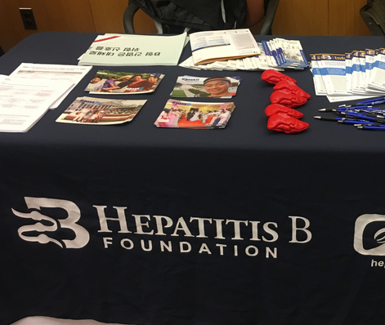
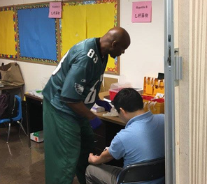



There are many ways that you can integrate hepatitis B education into your community.
Talk to community members about their health and hepatitis B risk.
Display educational fact sheets, brochures and posters in your office.
Host an education session, health fair or hepatitis B testing event.
Promote a local health fair that is testing for hepatitis B.
Share CDC's and the Hepatitis B Foundation's posts on social media.

Slide 45
PAGE | 00
Thank you for helping
spread the word about hepatitis B!

Slide 46
PAGE | 00
After viewing this presentation, please complete a short self-assessment.
Click Here!
Your feedback can help us provide you with the most useful resources!
For questions or additional support, email: info@hepb.org

