Slide 1


Why get tested for hepatitis B?
Why get tested for hepatitis B?
The facts you need to know!

Slide 2

How common is hepatitis B?
Worldwide
292 million people are living with hepatitis B
In the United States
More than 2 million people are living with hepatitis B
Hepatitis B is one of the world's most common infections

Slide 3
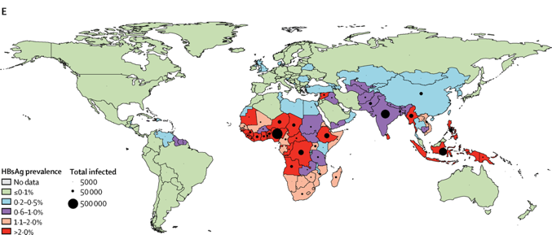
What areas of the world are common for hepatitis B?
Polaris Observatory Collaborators D, Gamkrelidze I, Nguyen MH, et al. Global prevalence, treatment, and prevention of hepatitis B virus infection in 2016: a modelling study. lancet Gastroenterol Hepatol. 2018;3(6):383-403. doi:10.1016/S2468-1253(18)30056-6

Slide 4


What is hepatitis B?
  A chronic (long-lasting) virus that infects the liver
  If hepatitis B is not taken care of, it can lead to liver cancer
  About 2.2 million people in the United States have hepatitis B
    Most people do not know they have hepatitis B
  There is a safe vaccine that can prevent hepatitis B and treatments can help manage hepatitis B for those who have it.

Slide 5

What is the liver?
What does it do?
  Digests food
  Regulates energy
  Builds muscle
  Breaks down toxins
  Fights infections
  Processes medications
  Stores vitamins
  Helps the blood to clot

Slide 6


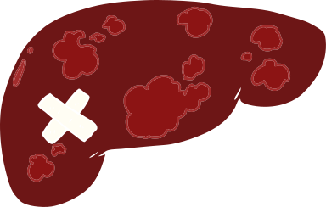
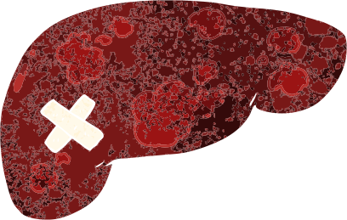
Hepatitis B Disease Progression
Healthy liver
Mild inflammation can lead to "fibrosis"
A lot of inflammation can lead to a scarred liver or Cirrhosis
Long-term infection with hepatitis B can lead to liver cancer
Hepatitis B can lead to liver damage and even liver cancer over time if someone is not aware of or managed for their infection.

Slide 7
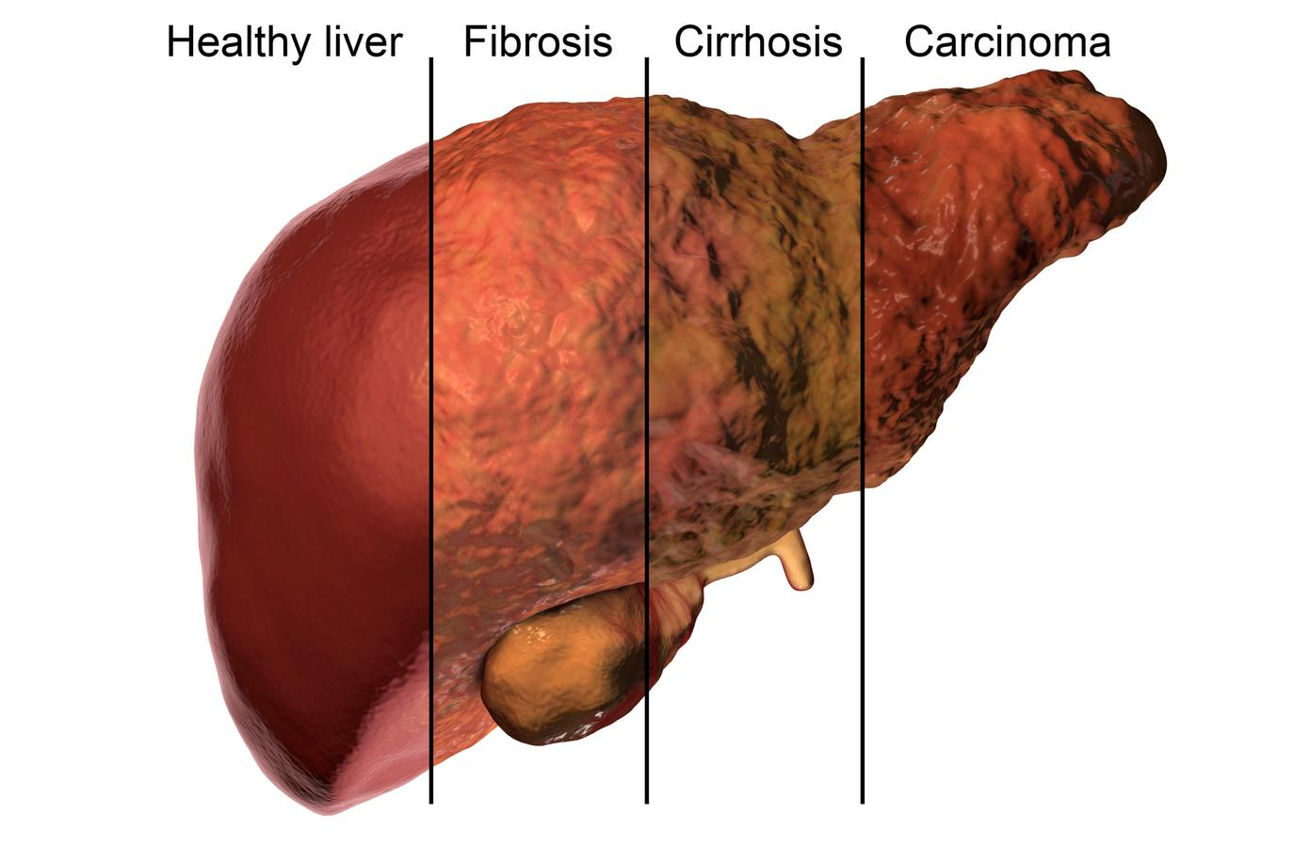
What does hepatitis B do to the liver?
  Scars it!
  Over time hepatitis B can harm your liver
  If left untreated, hepatitis B can cause liver damage or even liver cancer

Slide 8
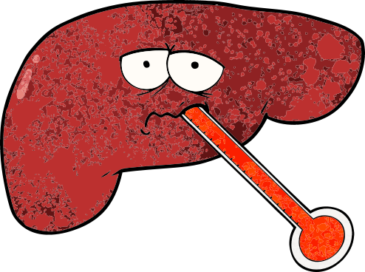
Are there symptoms of hepatitis B?
There are usually no signs or symptoms for hepatitis B if someone does have symptoms, they can be a sign of liver disease
Some people can experience flu like symptoms
  Fever
  Jaundice (yellowing of the skin and eyes)
  Dark urine
  Nausea
  Fatigue

Slide 9

How can someone get hepatitis B?
You can get hepatitis B from infected blood.
Hepatitis B is spread through blood to blood contact or sexual contact.
Hepatitis B can live outside the body for up to 7 days.

Slide 10

How can you get hepatitis B?
Most people become infected when they are very young.
Many pregnant women do not know they are infected and unknowingly transmit the virus to their babies due to blood exchange during childbirth.

Slide 11
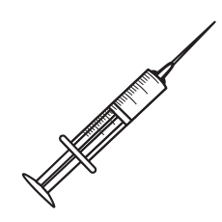

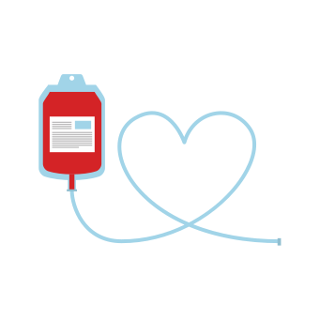

What puts someone at risk for hepatitis B?
  Getting tattoos, body art or body piercings with unsterile equipment
  Getting a blood transfusion or recieving a blood product before 1992
  Being a health care provider
  Using unsterile needles with recreational drugs
  Being born to a mother with hepatitis B
  Living with someone who has hepatitis B
  Being first of second generation coming from an area where hepatitis B is common

Slide 12
Hepatitis B is not spread through casual contact
Hepatitis B is NOT spread by casual contact like hugging, kissing, holding hands, sneezing, or sharing utensils.

Slide 13

The good news:
liver problems can be prevented by getting tested and seeing a doctor!
The test for hepatitis B is simple and easy and can help you and your family stay healthy!

Slide 14
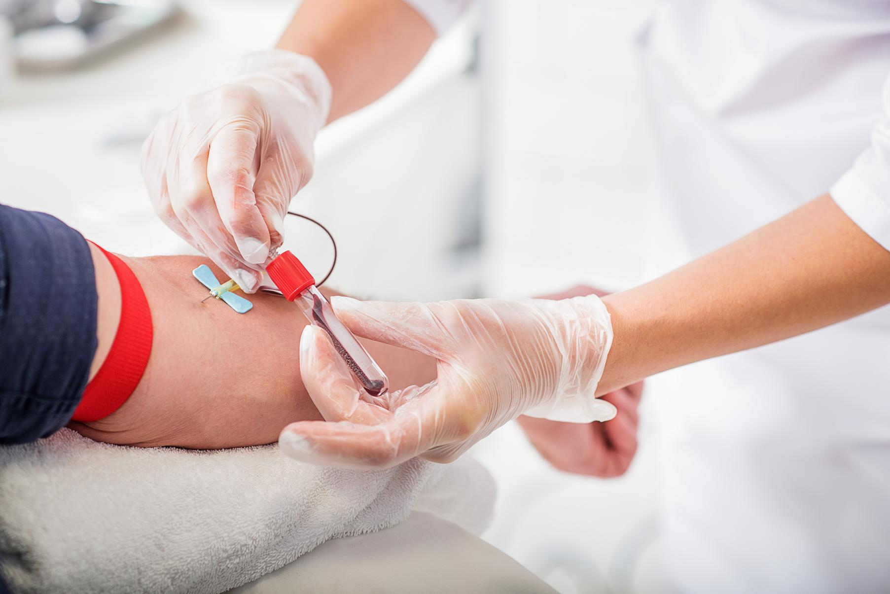
How do I find out if I have hepatitis B?
A simple blood test can check if you have hepatitis B.
The test is quick and easy and results should be ready in a few days!

Slide 15
What should I be tested for?
1) Hepatitis B Surface Antigen (HBsAg)
  A positive or reactive test means that a person is infected with hepatitis B
2) Hepatitis B Surface Antibody (HBsAb)
  A positive or reactive test means that a person is protected or immune against hepatitis B
3) Hepatitis B Core Antibody (HBcAb)
  A positive or reactive test means that a person has had an infection of hepatitis B or currently has an infection. This test tells us that a person has been exposed to hepatitis B at some point in their lifetime.

Slide 16




If I have hepatitis B right now, what can I do?
There are treatments that can prevent liver cancer and save lives- the key is knowing if you have hepatitis B so you can take action
Take care of your liver:
  Stop drinking alcohol
  Lose weight if you are overweight
  Quit smoking
  Eat Healthy foods
  Exercise
It is important to check in with your doctor every 6-12 months to monitor your liver health

Slide 17
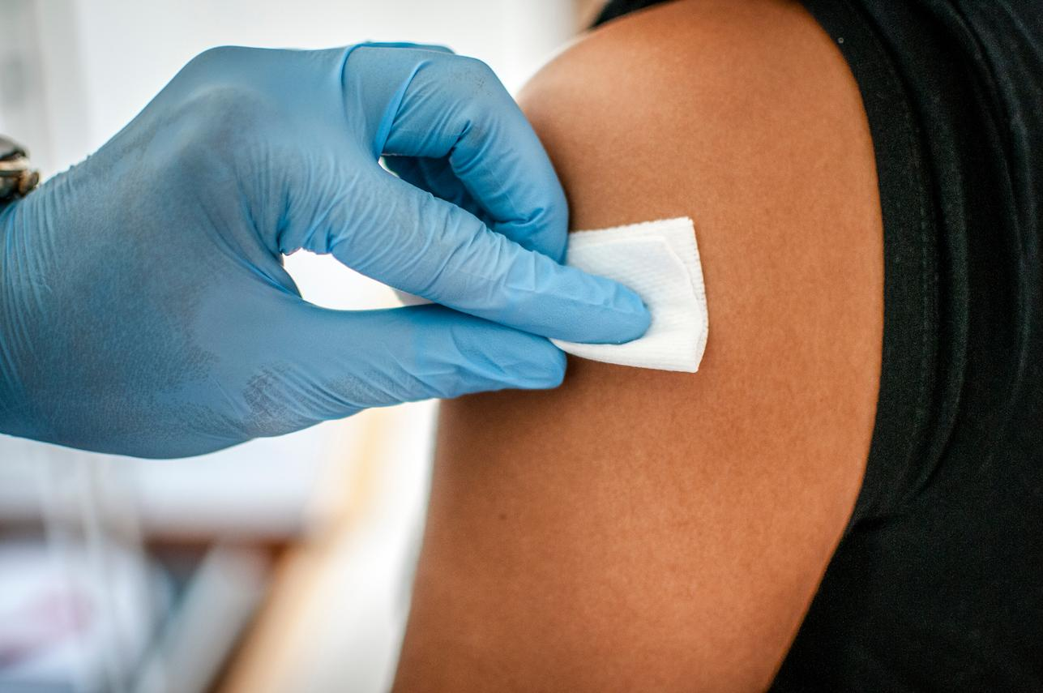
How can I protect myself from hepatitis B?
There is a safe vaccine
that can protect
you against hepatitis B. It can take only 2-3 doses to protect you for life.
Ask your doctor or pharmacy about the hepatitis B vaccine.

Slide 18






How can you help stop hepatitis B from spreading?
Don't share toothbrushes, razors, nail clippers or other personal items
Cover cuts until they are healed
Clean up blood
Practice safe sex
Don't share or reuse needles or equipment including cookers, spoons,& cotton

Slide 19
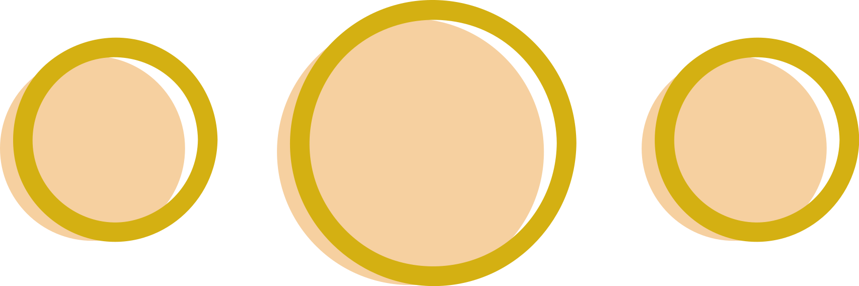
Where can I get tested for hepatitis B?
Community
Health
Screening
Your primary
care doctor
Federally Qualified
Health Centers (FQHC)
Ask your doctor to get tested for hepatitis B!

Slide 20

Where can I get vaccinated for hepatitis B?
Your
local pharmacy. Need help finding a pharmacy?
http://www.hepcap.org/community-tools/pharmacy-vaccine-maps/
Your
doctors office. Need help finding a doctor? https://www.hepb.org/treatment-and-management/physician-directory/

Slide 21
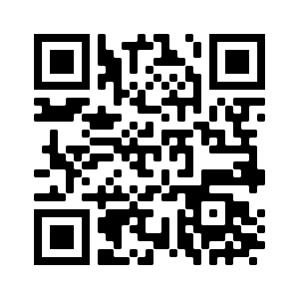
Are you interested in getting tested in Philadelphia, PA?
If you are interested in setting up a free hepatitis B test, you can contact Catherine.Freeland@hepb.org or at 267-603-1161
Sign up through the QR code or at this link: https://forms.gle/2LJijHr7WaDEStZP9

Slide 22
What do I do if I have questions about hepatitis B?
For more information, you can contact the Hepatitis B Foundation
at: www.hepb.org
Email: info@hepb.org
Phone: 215-489-4900
The Centers for Disease Control and Prevention also has helpful resources at www.cdc.gov/knowhepatitisB

Slide 23
THANK YOU!
Thank you all for attending.
Developed resources reported in this project are supported by the National Library of Medicine (NLM), National Institutes of Health (NIH) under cooperative agreement number UG4LM012342 with the University of Pittsburgh, Health Sciences Library System. The content is solely the responsibility of the authors and does not necessarily represent the official views of the National Institutes of Health

